Slide 1
13: Shadows and Multi-Pass Rendering

Slide 2
Reference & Reading
Slides from Real-time rendering Homepage (http://www.realtimerendering.com/)
Tomas Akenine-Möller
Hearn & Baker, Chapter 10
Watt, Chapter 6 and 9

Slide 3
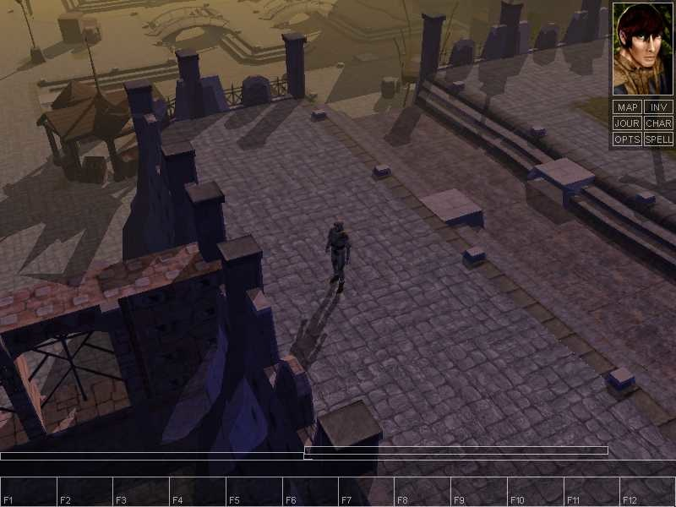
Why shadows?
More realism and atmosphere

Slide 4
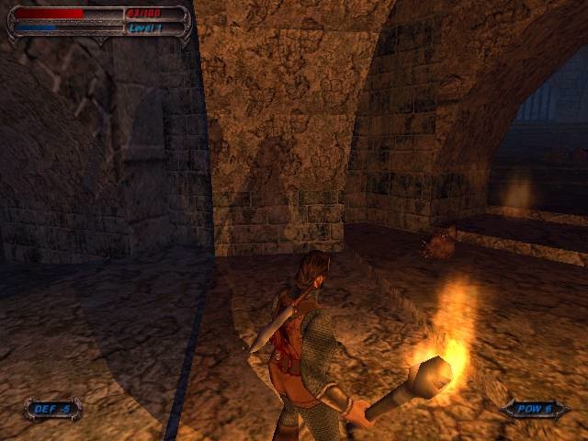
Another example

Slide 6
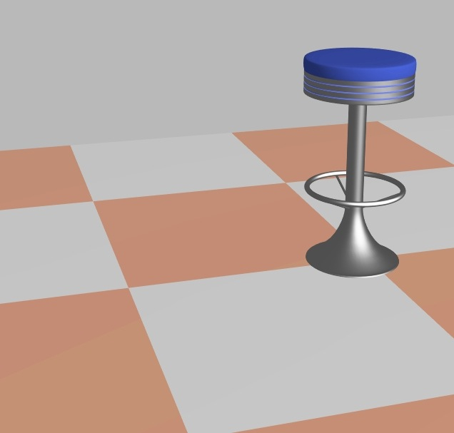
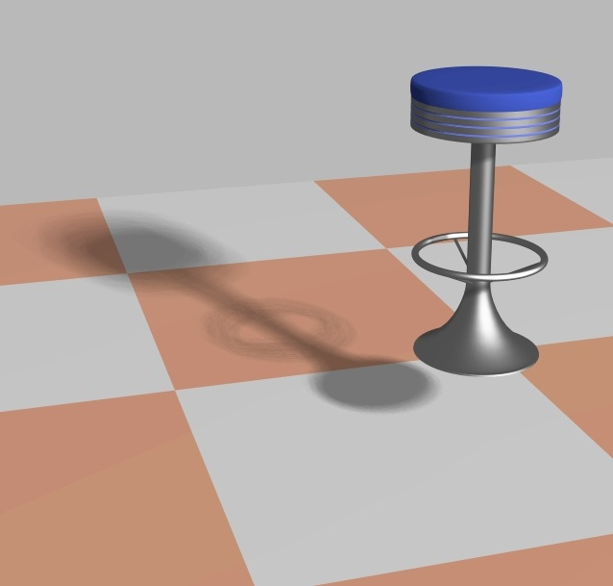
Why shadows?
More clues about spatial relationships
Orientation & gameplay

Slide 7
Definitions
Light sources
Shadow creators and receivers
Light source
Creator
Creator and
receiver
Receiver

Slide 8
Definitions
Light source types
point source
area source
umbra
penumbra
umbra

Slide 9
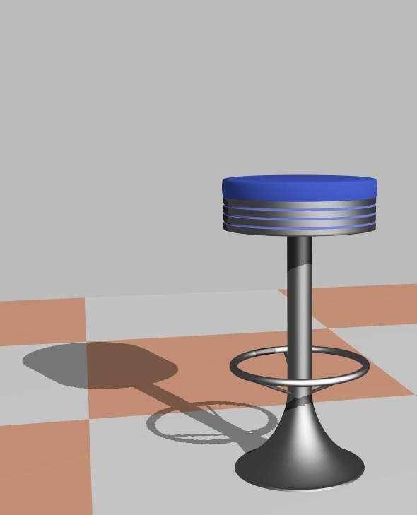

Example: hard vs soft shadows

Slide 10
Ways of thinking about shadows
As separate objects (like Peter Pan's shadow)
As volumes of space that are dark
As places not seen from a light source looking at the scene
Note that we already "have shadows" for objects facing away from light

Slide 11
Properties of Shadows
Shadow from polygon A fall on polygon B
Point light source
Projecting polygon A onto the plane of polygon B
Position of light source = center of projection
No shadows are seen when
View point = single light source
No penumbra, only umbra when
Point light source
Static scene, no light source motion
Shadows are fixed
Otherwise, the shadows have to be re-calculated.

Slide 12
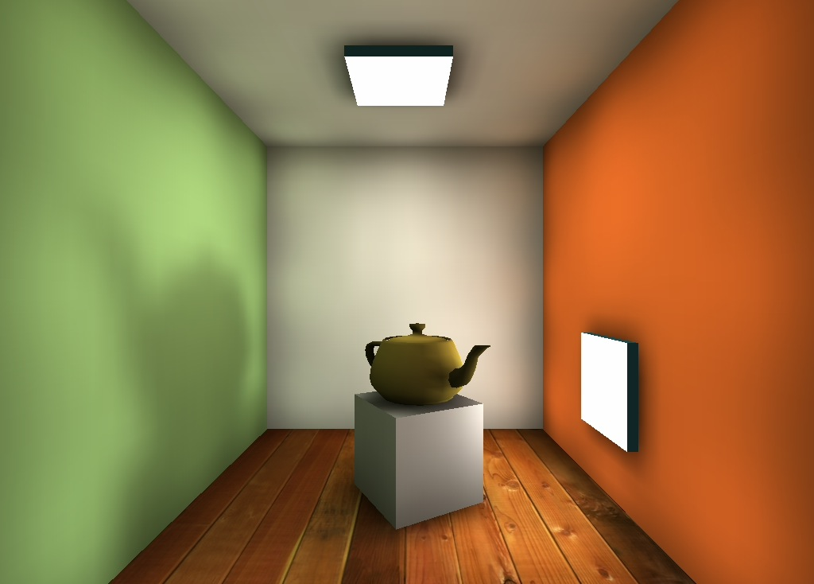
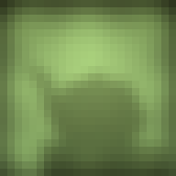
Store precomputed shadows in textures
Images courtesy of Kasper Høy Nielsen.
Tomas Akenine-Mőller © 2002

Slide 13
Shadow volumes
Shadow volume concept
Create volumes of space in shadow from each polygon in light.
Each triangle creates 3 projecting quads

Slide 14
Using the Volume
To test a point, count the number of polygons between it and the eye.
If we look through more frontfacing than backfacing polygons, then in shadow.
backfacing
frontfacing

Slide 15

Shadow volume algorithm uses stencil buffer
Stencil what?
Is just another buffer (often 8 bits per pixel)
When rendering to it, we can add, subtract, etc
Then, the resulting image can be used to mask off subsequent rendering
Stencil
Buffer
Mask
Rendered
image
result

Slide 16
How to implement shadow volumes with stencil buffer
A four pass process [Heidmann91]:
1st Pass: render the scene with just ambient lighting.
Turn off updating Z-buffer and writing to color buffer (i.e. Z-compare, draw to stencil only).
2nd pass: render front facing shadow volume polygons to stencil buffer, incrementing count.
3rd pass: render backfacing shadow volume polygons to stencil, decrementing.
4th pass: render diffuse and specular where stencil buffer is 0.

Slide 17
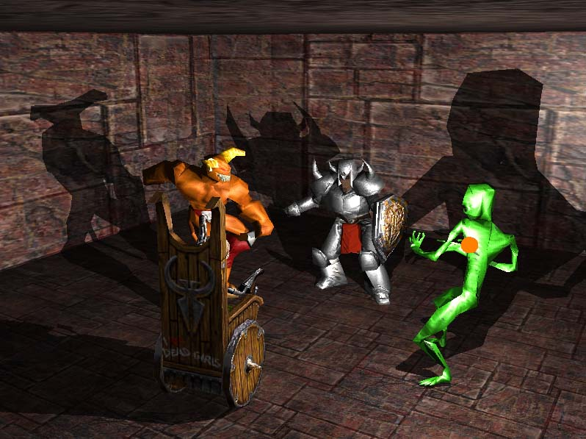
Shadow Volume Example

Slide 18
Merging Volumes
Edge shared by two polygons facing the light creates front and backfacing quad.
This interior edge makes
two quads, which cancel out

Slide 19
Silhouette Edges
From the light’s view, caster interior edges do not contribute to the shadow volume.
Finding the silhouette edge gets rid of many useless shadow volume polygons.

Slide 20
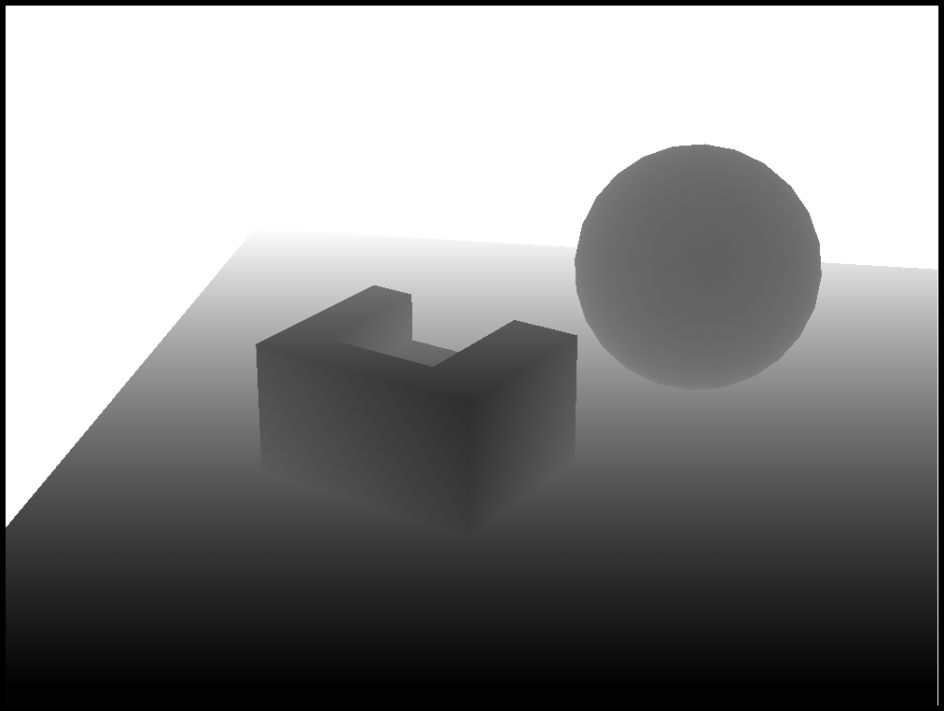
Shadow Mapping
Shadow mapping and shadow volumes
Focus on shadow volumes, because currently most popular, and works on most hardware
Works in real time…
Shadow mapping is used in Pixar’s rendering software
Render from light’s view (white is far and black is near)

Slide 21
Shadow Mapping
Render from light’s view (white is far and black is near)
Shadow mapping is used in Pixar’s rendering software

Slide 22
Using the Shadow Map
When scene is viewed, check viewed location in light's shadow buffer
If point's depth is (epsilon) greater than shadow depth, object is in shadow.
For each pixel, compare
distance to light with
the depth stored in
the shadow map
shadow
depth map

Slide 23
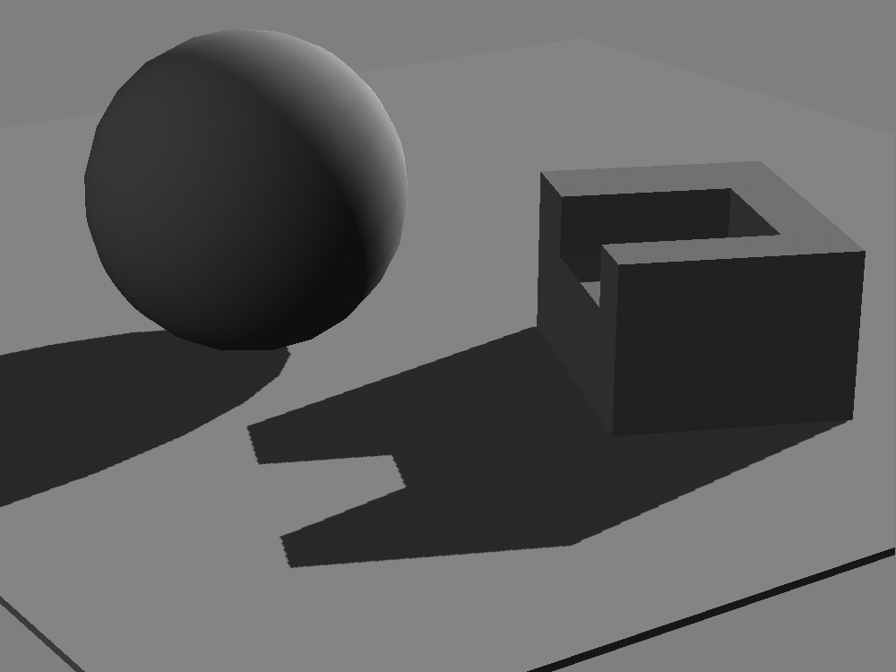
The Result

Slide 24
Shadow Mapping in OpenGL
Shadow Map Creation: Shadow Texture
glGenTextures(1, &shadowTex);
glBindTexture(GL_TEXTURE_2D, shadowTex);
glTexImage2D(GL_TEXTURE_2D, 0,GL_RGB32F, 1024, 1024, 0,GL_RGB, GL_FLOAT, 0);
glTexParameteri(GL_TEXTURE_2D, GL_TEXTURE_MAG_FILTER, GL_LINEAR);
glTexParameteri(GL_TEXTURE_2D, GL_TEXTURE_MIN_FILTER, GL_LINEAR);
glTexParameteri(GL_TEXTURE_2D, GL_TEXTURE_WRAP_S, GL_CLAMP_TO_EDGE);
glTexParameteri(GL_TEXTURE_2D, GL_TEXTURE_WRAP_T, GL_CLAMP_TO_EDGE);

Slide 25
Shadow Mapping in OpenGL
Shadow Map Creation: Depth Buffer
glGenTextures(1, &shadowDepth);
glBindTexture(GL_TEXTURE_2D, shadowDepth);
glTexImage2D(GL_TEXTURE_2D, 0,GL_DEPTH_COMPONENT32F, 1024, 1024, 0,GL_DEPTH_COMPONENT, GL_FLOAT, 0);
glTexParameteri(GL_TEXTURE_2D, GL_TEXTURE_MAG_FILTER, GL_LINEAR);
glTexParameteri(GL_TEXTURE_2D, GL_TEXTURE_MIN_FILTER, GL_LINEAR);
glTexParameteri(GL_TEXTURE_2D, GL_TEXTURE_WRAP_S, GL_CLAMP_TO_EDGE);
glTexParameteri(GL_TEXTURE_2D, GL_TEXTURE_WRAP_T, GL_CLAMP_TO_EDGE);

Slide 26
Shadow Mapping in OpenGL
Shadow Map Creation: FBO
glGenFramebuffers(1, &shadowFBO);
glBindFramebuffer(GL_FRAMEBUFFER, shadowFBO);
glFramebufferTexture(GL_FRAMEBUFFER, GL_COLOR_ATTACHMENT0, shadowTex, 0);
glFramebufferTexture(GL_FRAMEBUFFER, GL_DEPTH_ATTACHMENT, shadowDepth, 0);
GLenum drawBuffers[] = {GL_COLOR_ATTACHMENT0};
glDrawBuffers(1, drawBuffers);
if(glCheckFramebufferStatus(GL_FRAMEBUFFER) != GL_FRAMEBUFFER_COMPLETE) printf("FBO Error\n");
glBindFramebuffer(GL_FRAMEBUFFER, GL_NONE);

Slide 27
Setting up MVP Matrix for Depth Map
Light Direction
glm::vec3 lightPos = glm::vec3(3,3,3);
Compute the MVP matrix from the light's point of view
mat4 shadowProjMat = ortho (-2,2,-2,2,0.01,10);
mat4 shadowViewMat = lookAt(lightPos, vec3(0,0,0), vec3(0,1,0));
mat4 shadowMVP = shadowProjMat * shadowViewMat * modelMat;
Set matrices
glUniformMatrix4fv(loc, 1, 0, value_ptr(shadowMVP));

Slide 28
Shaders to Create Shadow Map
Note: it is a different program from lighting program
Vertex Shader
#version 330 core
layout(location = 0) in vec3 in_Position;
uniform mat4 shadowMVP;
void main(){
gl_Position = shadowMVP * vec4(in_Position,1);
}
Fragment Shader: Write depth only
#version 330 core
layout(location = 0) out vec3 fragmentdepth;
void main(){ fragmentdepth = vec3(gl_FragCoord.z); }

Slide 29
Sample Result of the Shadow Map

Slide 30
Rendering Using Shadow Map
Bind Shadow map as a texture
Shadow bias matrix
To test depth, each vertices should be transformed as in shadow map
Texture coordinate is between 0 and 1 but normalized coordinate is between -1 to 0
shadowBiasMVP handles this problem
mat4 biasMatrix= translate(vec3(0.5))*scale(vec3(0.5));
mat4 shadowBiasMVP = biasMatrix*shadowMVP;

Slide 31
Rendering Using Shadow Map
Vertex Shader
… out vec4 shadowCoord;
…uniform mat4 shadowBiasMVP;
shadowCoord = shadowBiasMVP * vec4(in_Position,1);
Fragment Shader
in vec4 shadowCoord;
uniform sampler2D shadowMap;
…
vec3 sCoord = shadowCoord.xyz/shadowCoord.w;
float visibility = 1.0;
if( texture( shadowMap, sCoord.xy).z < sCoord.z ) visibility = 0.5;
… out_Color = vec4( color*visibility, 1 );

Slide 32
Result

Slide 33
Problem
Shadow acne

Slide 34
Shadow Map Bias
Shift shadow map in opposite direction to light
float bias = 0.005 * tan(acos(dot(N,L)));
float visibility = 1.0;
if ( texture( shadowMap, sCoord.xy ).z < sCoord.z-bias)
visibility -= 0.5;

Slide 35
Peter Panning
Due to the Bias
Make geometry thick!!

Slide 36
Aliasing
Shadow is not smooth
Limited resolution of shadow map

Slide 37
Multi Sampling (Percentage Closer Filtering)
Sample shadow map more than one time
Offset the shadow map coordinate little bit
Poisson distribution is often used
vec2 poissonDisk[4] = vec2[](
vec2( -0.94201624, -0.39906216 ),
vec2( 0.94558609, -0.76890725 ),
vec2( -0.094184101, -0.92938870 ),
vec2( 0.34495938, 0.29387760 ) );
…
for (int i=0;i<4;i++){
if ( texture( shadowMap, sCoord.xy
+ poissonDisk[i]/700.0 ).z < sCoord.z-bias )
visibility-=0.2;

Slide 38
Example Can Be Found
Explained:
http://www.opengl-tutorial.org/intermediate-tutorials/tutorial-16-shadow-mapping/
Complete Example
https://learnopengl.com/Advanced-Lighting/Shadows/Shadow-Mapping

Slide 39
Better Percentage Closer Filtering
Randomize samples over fragments
Random Function per fragment and index
float random(int i) {
float dot_product = dot(vec4(gl_FragCoord.xyz,i), vec4(12.9898,78.233,45.164,94.673));
return fract(sin(dot_product) * 43758.5453);
}
…
for (int i=0;i<4;i++){
int index = int(random(i)*16)%16;
if( texture( shadowMap, sCoord.xy + poissonDisk[index]/700.0) < sCoord.z-bias )) visibility-=0.2;
}

Slide 40
Percentage-Closer Soft Shadows
Soft Shadow
Light is big
Some only a part of light is blocked (penumbra)
The size of penumbra is dependent on
Light size
The distance between light and blocker,
The distance between light and receiver

Slide 41
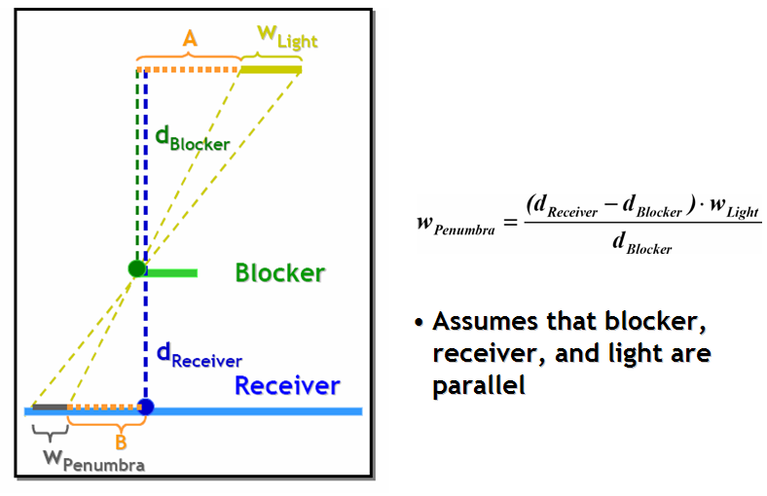
Penumbra Size

Slide 42
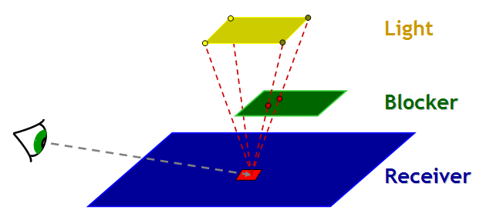
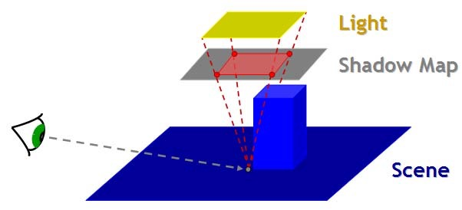
Percentage-Closer Soft Shadows
Search Blockers
Sample shadow map
Decide sample radius using light size
Compute penumbra size
PCF using a kernel size proportional to the penumbra

Slide 43
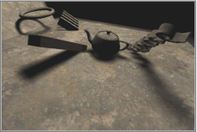
Result

Slide 44
Assignment #6 (Triple Score!!)
Shadow mapping
Create FBO for shadow map
Write another vertex shader and fragment shader for shadow map rendering (shadowProg)
Setup shadowProg for shadow map rendering
Activate FBO and render scene
Modify the lighting vertex/fragment shader (program)
Setup program (set shadow map as texture)
Render once more with lighting program
Scoring
Basic shadow: 15 points
Reasonable shadow: 20 points
Point light shadow: 25 points
PCF: 30 points

